Slide 1
The pathogen sequencing toolbox
EMD 531
Lecture 3
Chantal Vogels, PhD

Slide 2
Learning objectives
Students will be able to
Explain next-generation sequencing
Compare different sequencing approaches and platforms
Choose appropriate sequencing methods to answer questions

Slide 3
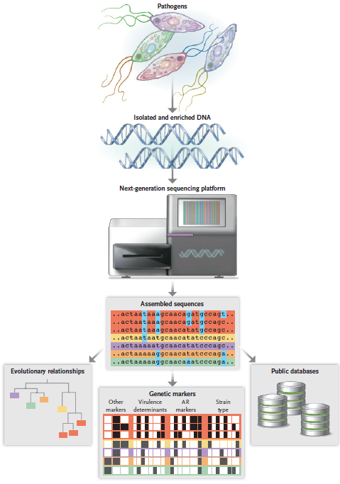
Pathogen genomics workflow
Armstrong et al. (2019) NEJM

Slide 4
What is next-generation sequencing?

Slide 5
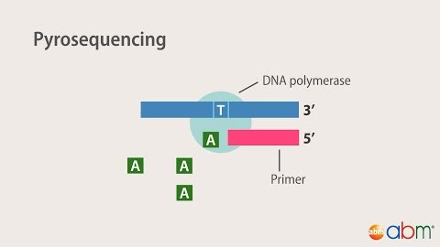

Slide 6
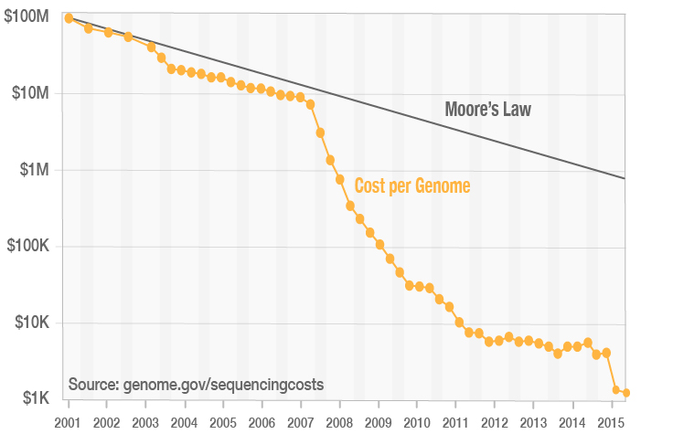
 | Sanger | Next-generation sequencing
Sample size | 1 strand per base | 1 strand per sequence
Speed | Single reads | Massively parallel
Cost (human genome) | $10.000.000 | $1.000
Accuracy | Low | High (higher coverage)
Read length | Long (700-1000bp) | Short (100-200bp)
EMBL-EBI: NGS Practical Course

Slide 7
Sequencing approaches and platforms

Slide 8


Total Nucleic Acid
Pathogen RNA or DNA
Host RNA
Host DNA

Slide 9
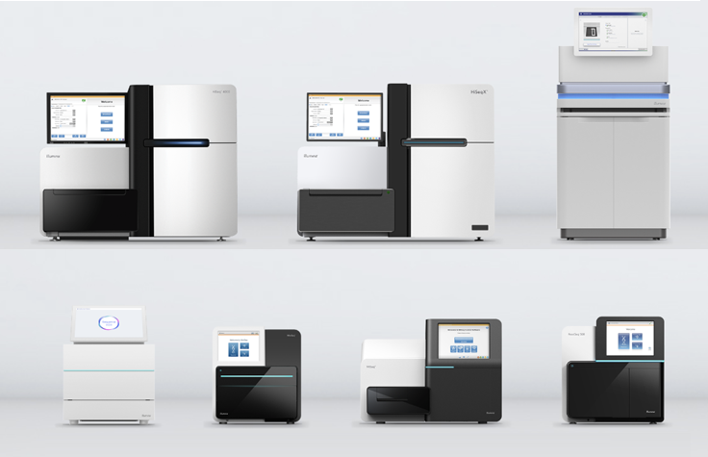
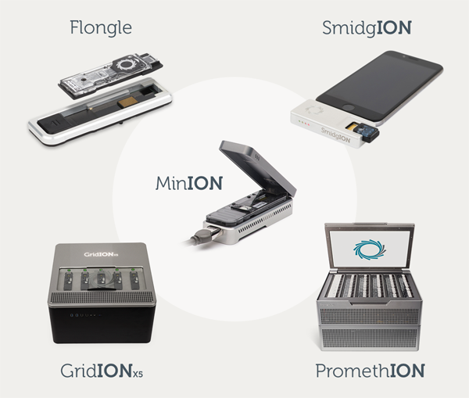
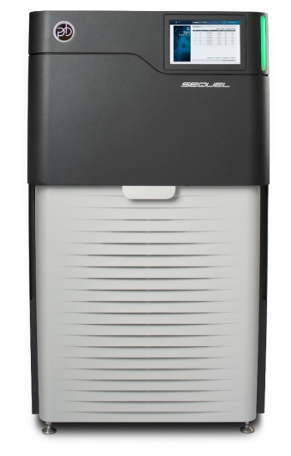
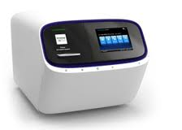
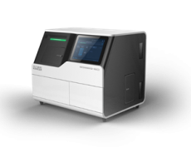
Nanopore
Illumina
Pacbio
Ion
BGI

Slide 10
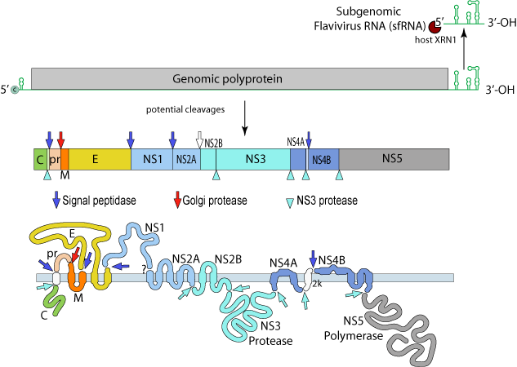
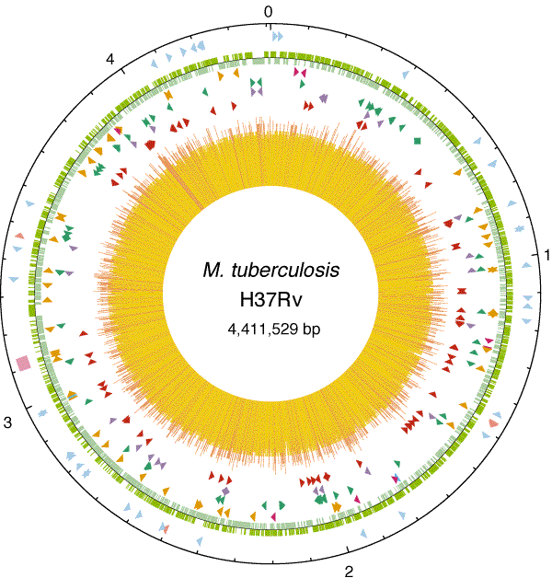
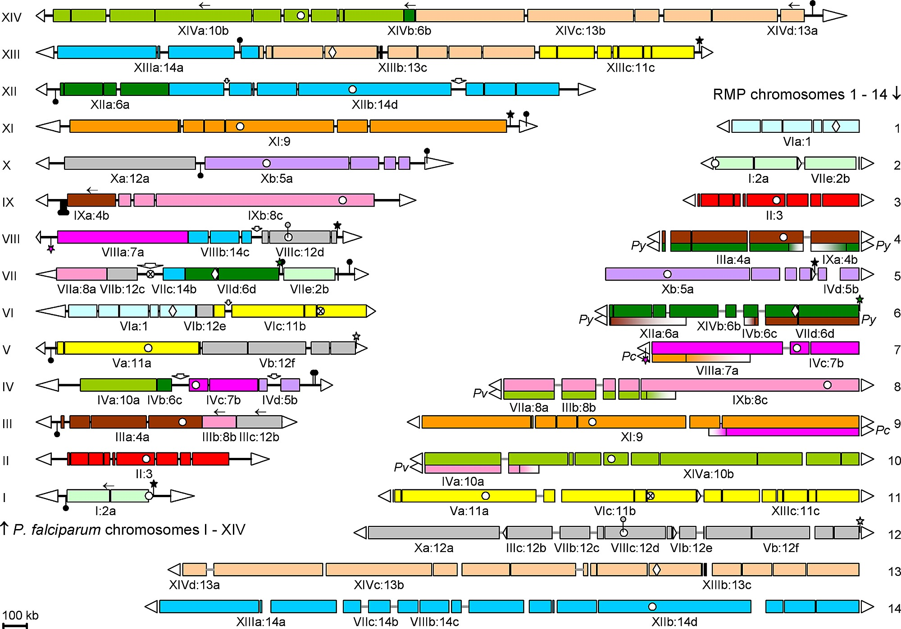
Challenges in sequencing of pathogens
Viruses
E.g. Zika virus: 11kb
→ Whole genome
Bacteria
E.g. Mycobacterium tuberculosis: 4.4Mb
→ 16S rRNA
Protozoa
E.g. Plasmodium falciparum: 22.9Mb
→ Targeted genes
Viral Zone
Cole et al. (1998) Nature
Kooij et al. (2005) PLOS Pathogens

Slide 11
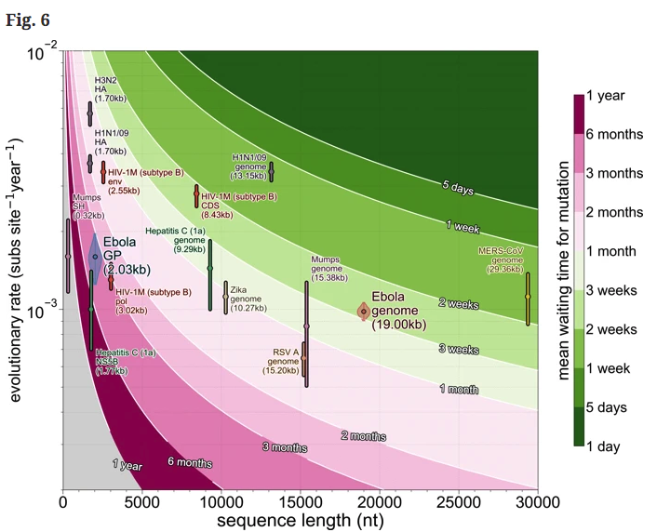
Whole genome versus targeted gene sequencing
Dudas & Bedford (2019) BMC Evolutionary Biology

Slide 12
How to match a method with a question?

Slide 13
Question + Samples + Resources = Tool

Slide 14
Question
What pathogen is in my sample?
Unknown – need unbiased method
Sequencing depth – need lots of data/sample
How is the pathogen evolving during an outbreak?
Known – can use a targeted method
Sample size – need to sequence lots of viruses
How is the pathogen evolving within a host?
Known – can use a targeted method if accurate
Sequencing depth – need lots of data/sample

Slide 15
Samples
Target to background ratio
Sample type and pathogen dependent (e.g. Zika virus in serum)
CT values, house-keeping genes, total nucleic acid, carrier RNA?
Determines unbiased versus targeted approach
Integrity
RNA/DNA extraction and storage
Determines read/amplicon lengths

Slide 16
Resources
Money $$
Do you have enough $$ to generate the required data?
Determines library prep and platform
Time
How quickly do you need the data?
Determines platform
Environment
Fully-equiped molecular biology lab? With personal sequencer?
Access to a genomics core?
In the field or other resource-limited environment?
What capacity do you have to analyze data?
Determines library prep and platform
Don’t be an ”Illumina Lab” just because you have a MiSeq

Slide 17
Question + Samples + Resources = Tool
Tool = Library prep + Sequencing platform

Slide 18
Tools – Library prep
Untargeted metagenomics
Sequence everything
Slightly biased additions
Dnase treatment
Host RNA depletion (e.g. rRNA)
Pros
Gold standard for pathogen sequencing (limited biases)
Do not need to know what you are looking for
Cons
Often requires lots of data/sample to cover target
Computationally challenging

Slide 19
Tools – Library prep
Targeted/enriched metagenomics
Sequence mostly target, but other stuff too
Examples
Spiked-primers during cDNA synthesis
Target capture probes pre or post library prep
Pros
Enhance target sequencing with minimal biases
Can scale for lots of potential targets (all DENV, all flaviviruses, all viruses)
Cons
Increases time, money, and skill of library prep

Slide 20
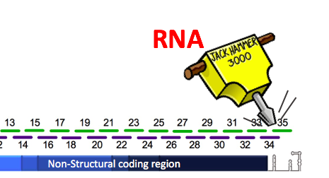
Tools – Library prep
Targeted PCR amplification
Sequence only target
Examples
16S for bacteria
Overlapping multiplexed for near-complete virus genomes (PrimalSeq)
Pros
Cheap and easy
Scalable for generating large datasets
Requires minimal sequencing data
Cons
Biased amplification
Easy to contaminate

Slide 21
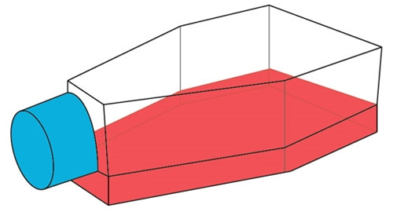
Tools – Library prep
Culture isolation and selection
Isolate bacteria from growth medium
Enrich for virus in cells prior to standard sequencing
Grow protozoa in culture
Still commonly used in surveillance programs
Pros
Broad enrichment for pathogens that easily replicate in culture
Mostly pathogen RNA/DNA, requires minimal sequencing data
Cheap
Cons
Biased pathogen composition (among species and intra-host populations)
Potential for culture selection and adaptations

Slide 22
Tools – Sequencing platform
Large-Scale
E.g., Illumina NovaSeq, HiSeq; PacBio; Nanopore PromethION
Most data/$, but expensive per run
Not affordable by most individual labs (genomics cores)
Mid-Scale
E.g., Illumina MiSeq, NextSeq; Ion Torrent; Nanopore GridION
mid data/$
Affordable by some individual labs, requires maintenance
Portable
E.g., Illumina iSeq; BGI DNBseq; Nanopore MinION
Low data/$, but cheap per run
Affordable and can be set up in many locations

Slide 23
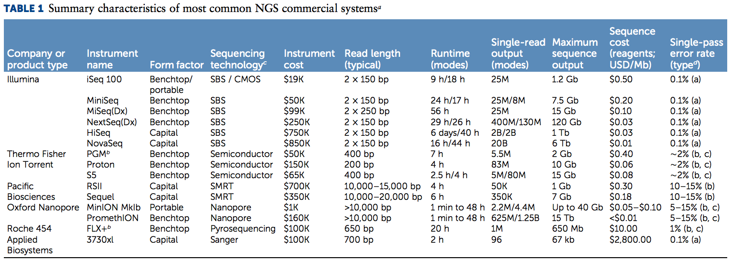
Tools – Sequencing platform
Maccannell. 2018. Platforms and Analytical Tools Used in Nucleic Acid Sequence-Based Microbial Genotyping Procedures

Slide 24
Tools – Sequencing platform
Platform | Expected Yield (Gb) | Seq Kit Cost | Estimated Cost/Gb
Illumina iSeq | 1 | $600 | $600.00
Illumina MiSeq | 15 | $1,625 | $108.33
Illumina HiSeq | 1500 | $6,810 | $4.54
Illumina NovaSeq | 6000 | $5,500 | $0.92
ONT MinION | 10 | $675 | $67.50
ONT GridION | 150 | $3375 | $22.50
ONT PromethION | 3800 | $19,200 | $5.05

Slide 25
Tools – Sequencing platform
Illumina
MiSeq/NovaSeq
Accurate sequencing, short reads
Good for generating lots of data (NovaSeq)
Expensive to run and maintain
Uses:
Large projects (samples in home lab)
Accurate sequencing (intrahost, metagenomics)
Long reads, error prone
Good for generating quick data
Rugged, cheap to run (reusable flowcells)
Uses:
Field or limited resources
Lab for long reads and quick data

Slide 26
Controls + accuracy
Controls
Negative controls at important steps (sample collection, RNA extraction, PCR, etc)
“Healthy” or environmental controls (metagenomics to determine background)
Internal controls to measure efficiency of library prep and validate sequencing
Normalize input target concentrations (important for comparing intrahost diversity)
Improving accuracy
Dual-indexes (reduces “index” hopping)
High-fidelity polymerases (reduces library prep errors)
Sequence technical replicates (removes sequencing errors)
Unique molecular identifiers (UMIs, removes sequencing errors)

Slide 27
Class activity: Sequencing approaches for mock scenarios

Slide 28
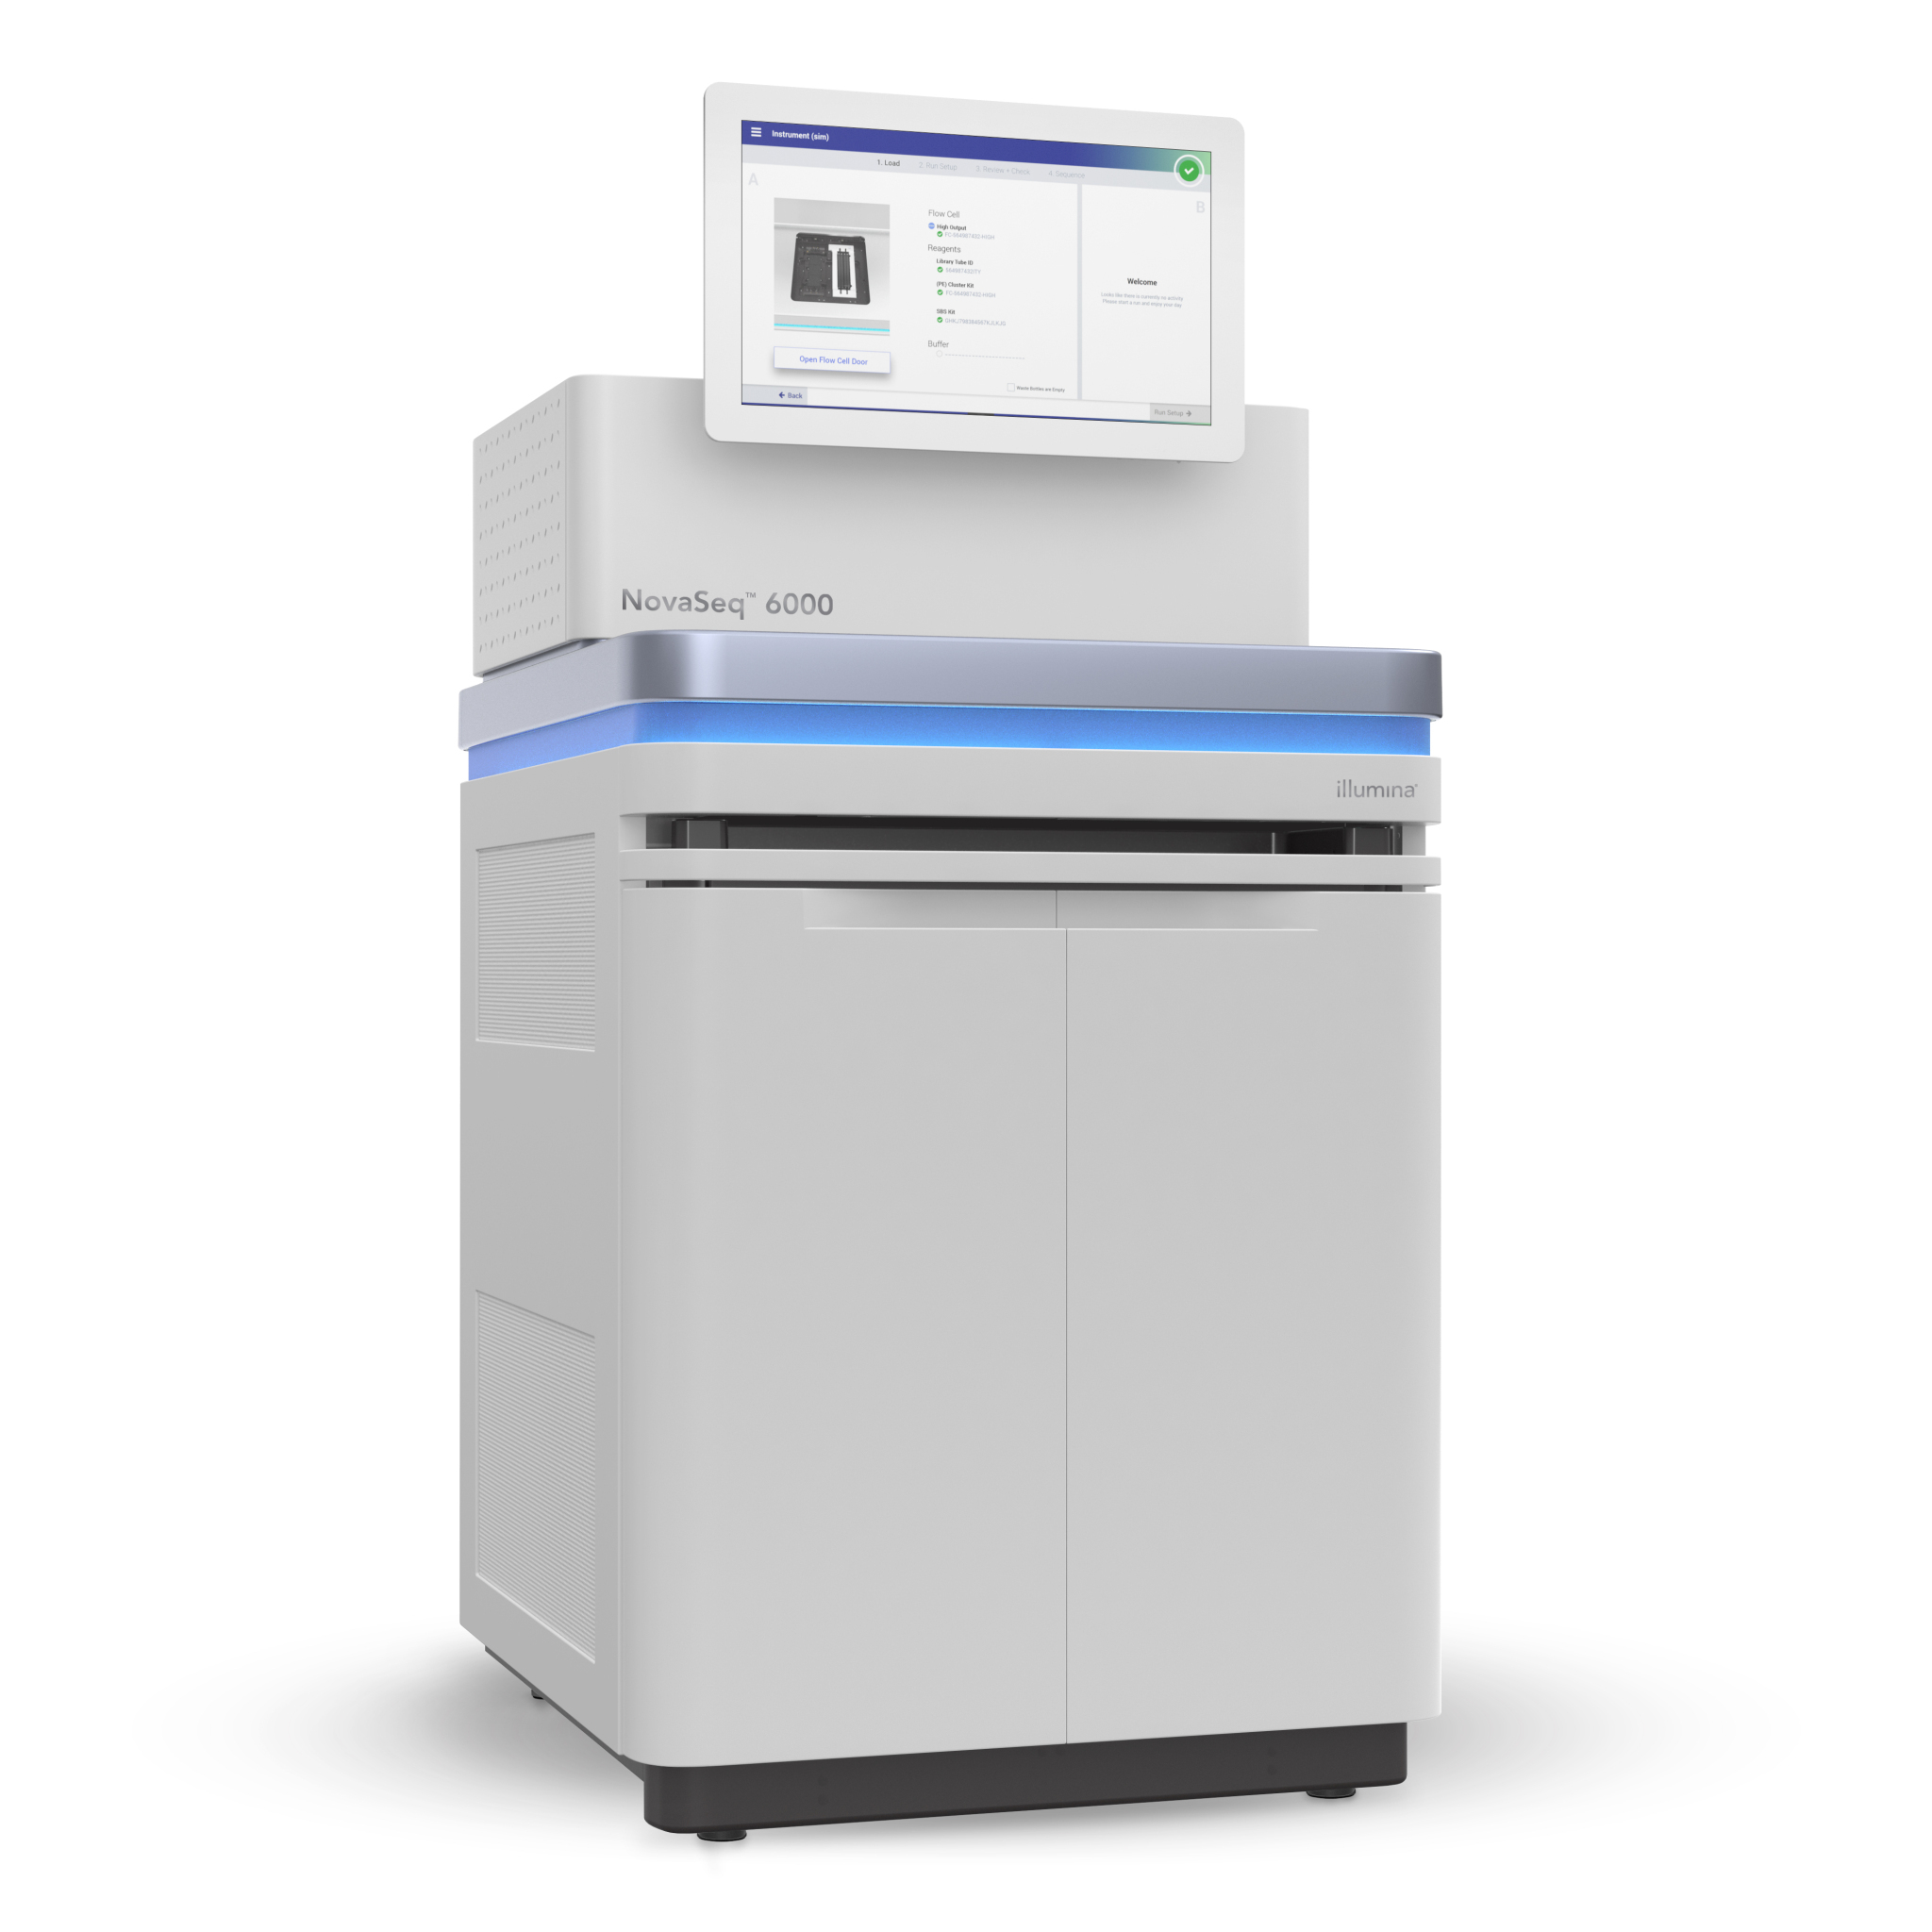
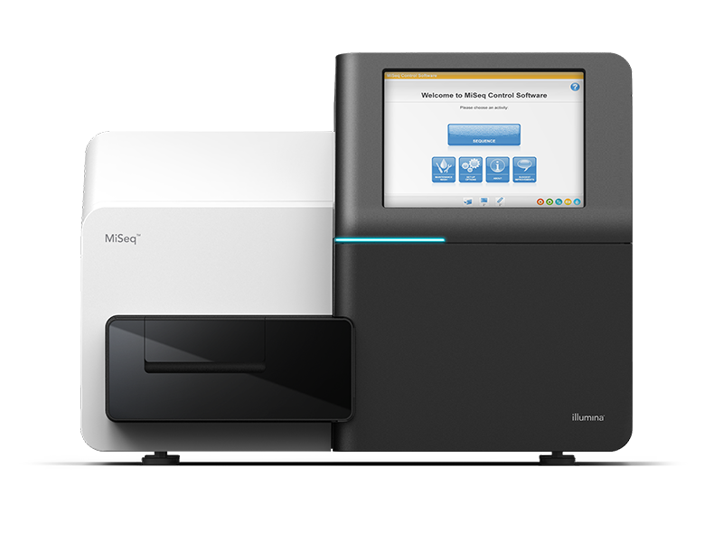
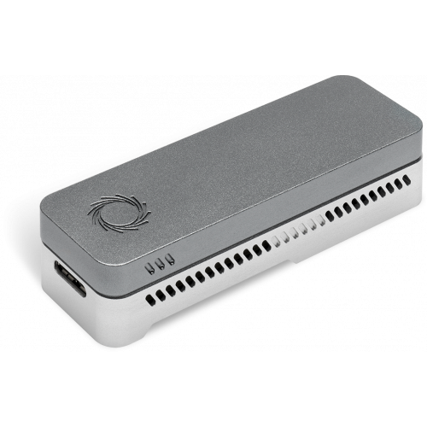
Library prep
Platform
Untargeted
Targeted
Illumina
Metagenomics
MiSeq
NovaSeq
Amplicon
Nanopore
PollEv.com/cvogels425
MinION

Slide 29
Scenario #1
Question
An unknown pathogen causing an outbreak of pneumonia in Wuhan, China
Samples
Blood and sputum samples
Dozens of samples
Resources
State-of-the-art molecular lab
No genomics core
Need data fast
Tools?
Library prep
Platform
PollEv.com/cvogels425

Slide 30
Scenario #2
Question
Clinical metagenomics for unknown causes of encephalitis (population study, not for diagnostics)
Samples
Cerebral spinal fluid, maintained on cold chain
Hundreds of samples
Resources
Well funded clinical lab
Access to Genomics Core
Not time sensitive
Tools?
Library prep
Platform
PollEv.com/cvogels425

Slide 31
Scenario #3
Question
Investigating 2019 dengue virus outbreak in Honduras
Samples
Serum, low CTs, somewhat degraded
Hundreds of samples
Resources
Mobile field lab
Need data fast
Tools?
Library prep
Platform
PollEv.com/cvogels425

Slide 32
Scenario #4
Question
Characterizing drug-resistance genes in Mycobacterium tuberculosis
Samples
Sputum samples
Dozens of samples
Resources
Basic molecular lab
Time sensitive
Tools?
Library prep
Platform
PollEv.com/cvogels425

Slide 33
Scenario #5
Question
Identifying SNPs in Plasmodium falciparum virulence genes
Samples
Serum samples
Dozens of samples
Resources
Well funded clinical lab (not much NGS experience)
Access to Genomics Core
Not time sensitive
Tools?
Library prep
Platform
PollEv.com/cvogels425

Slide 34
Scenario #6
Question
Are two mutations ~500nt apart co-occurring on the same virus genome (pilot study)?
Samples
Cell culture supernatant, mixed infections
Few samples
Resources
Basic molecular lab
Need data fast for PhD committee meeting
Tools?
Library prep
Platform
PollEv.com/cvogels425

Slide 35
Scenario #7
Question
Determining possible co-infections (bacteria and viruses) in ticks
Samples
Ticks
Hundreds of samples
Resources
State-of-the-art molecular lab
Access to Genomics Core
Not time sensitive
Tools?
Library prep
Platform
PollEv.com/cvogels425

Slide 36
Scenario #8: Your scenario?
Tools?
Library prep
Platform
PollEv.com/cvogels425

Slide 37
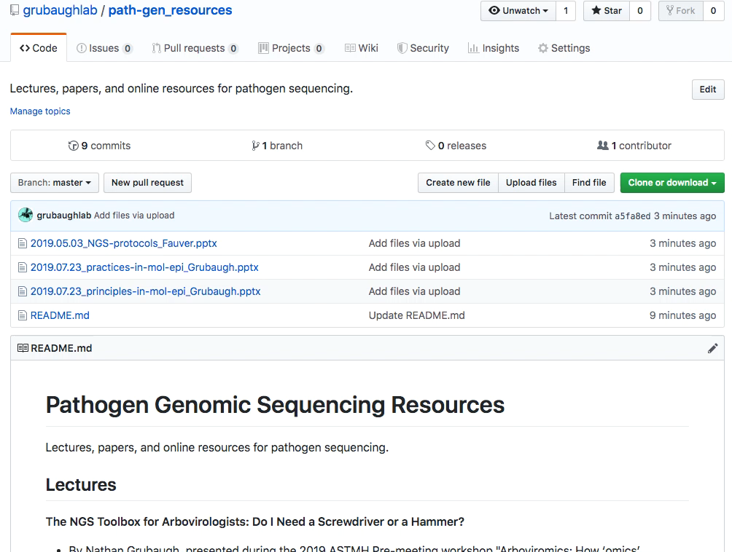
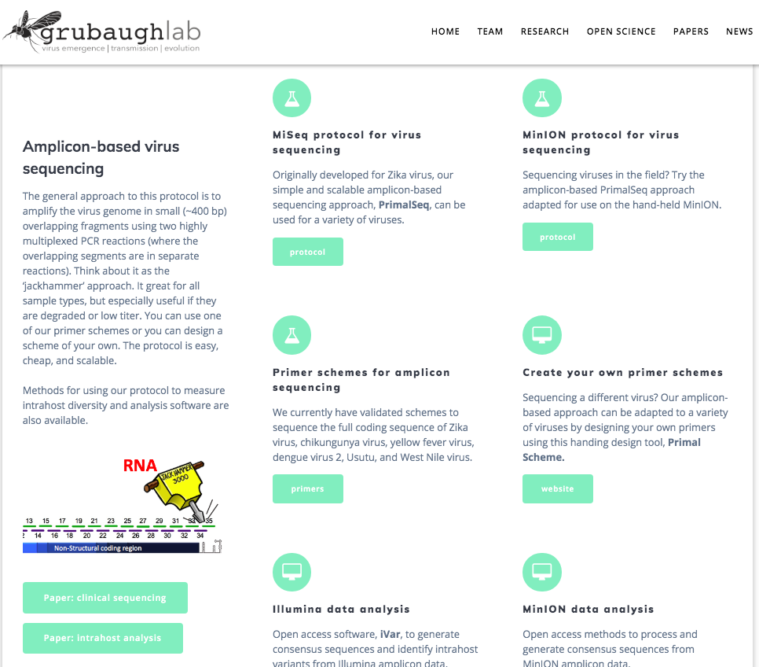
github.com/grubaughlab/path-gen_resources

